Slide 1
Bookstart 1-2 and Bookstart 3-4 Years Packs
Slides for partners

Slide 2
About BookTrust Cymru
BookTrust Cymru works to inspire a love of reading in children because reading can transform lives. Each year we reach thousands of children and families with our books, resources and support to get them started on their reading journeys.
Alongside their knowledgeable and experienced staff, BookTrust Cymru brings together:
A network of skilled delivery partners including local authorities, health visitors, schools, libraries, social workers and early years practitioners
A diverse community of children’s authors, illustrators and publishers
National agencies in England, Wales and Northern Ireland and book gifting organisations around the world
Committed and supportive funders, donors and friends

Slide 3
About BookTrust Cymru
BookTrust Cymru delivers engaging and impactful reading support to children and families.
Our aim is to bring the benefits of reading to children in the greatest need, with children and families at the heart of innovation, design and development of our programmes.

Slide 4
The benefits of reading
From babies to children in their early years and all the way through to early teens, reading brings profound and wide-ranging benefits that can have a lifelong positive impact on children’s lives.
Evidence shows that children who read:
Are more likely to overcome disadvantage caused by inequalities
Are more likely to be happier, healthier and experience better mental wellbeing and self-esteem
Are more likely to do better at school and make more progress across the curriculum
Are more likely to develop empathy and creativity
See BookTrust’s interactive benefits of reading resource for more information.

Slide 5
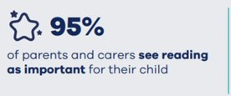
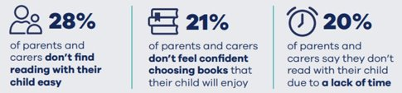
Reading in the early years
From BookTrust’s latest Family Survey, we know that whilst 95% of parents and carers
see reading as important for their child:
28% of parents and carers don’t find reading with their child easy
21% of parents and carers don’t feel confident choosing books that their child will enjoy
20% of parents and carers say they don’t read with their child due to a lack of time

Slide 6
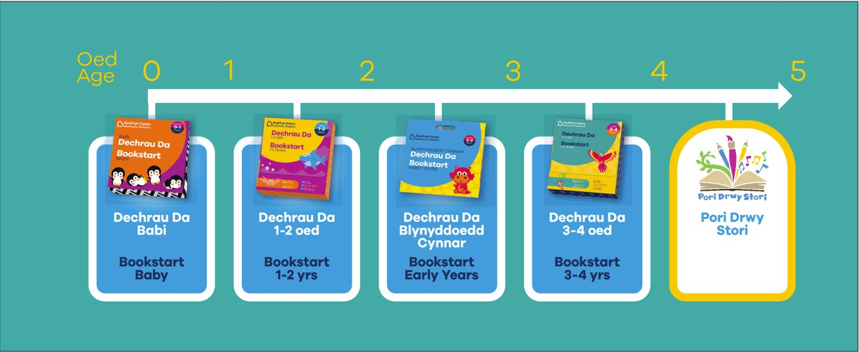
The BookTrust Cymru Reading Journey
BookTrust Cymru’s Early Years Reading Journey has been designed in collaboration with partners and families to encourage a love of books, stories and rhymes in children from as young an age as possible.

Slide 7
BookTrust Cymru’s Bookstart 1-2 Years and Bookstart
3-4 Years Offer
Bookstart 1-2 Years and Bookstart 3-4 Years launched as a pilot in June 2022.
The target audience for these resources is lower income families with children aged 1-4, who may need more help to make shared reading a regular part of their lives.
Our research tells us that whilst most families in this group know reading is important, many face barriers in making reading together a regular part of daily life.
BookTrust Cymru developed this programme in close collaboration with families from its target groups, and our expert partners.
BookTrust has worked with local authorities to identify over 6,000 delivery partners across England, Wales and Northern Ireland, including nurseries, children’s centres, libraries, health visiting teams, and charities and community organisations.
In its first year, partners supported BookTrust to gift over 390,000 book packs and resources to families.

Slide 8
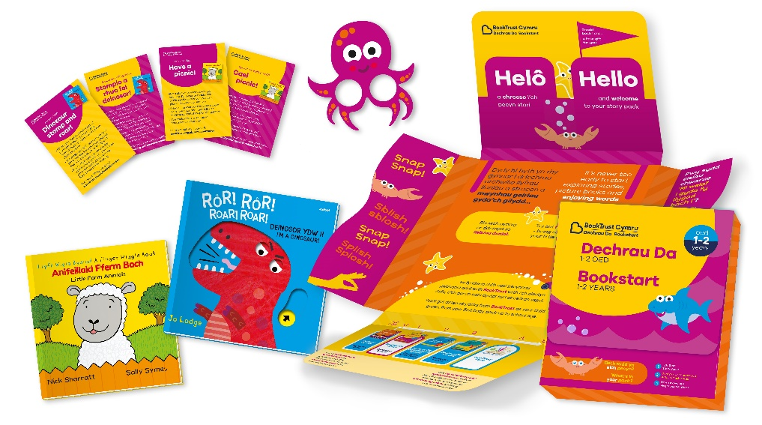
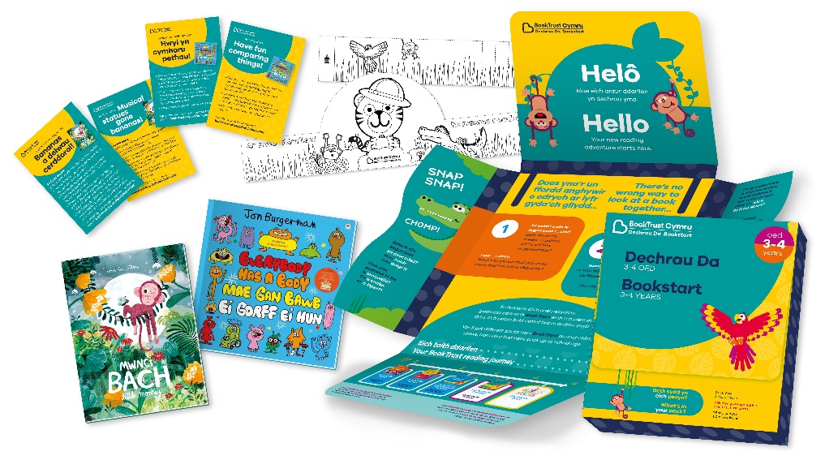
Bookstart 1-2 Years and Bookstart 3-4 Years
Families who responded to BookTrust Cymru's Parent and Carer Survey
2022-23 said that sharing the books and activities in their
Bookstart 1-2 Years or Bookstart 3-4 Years pack has helped them to bond,
make memories and encourage interaction:
98% said that they/their child enjoyed using the pack
85% said their child learnt something new from the
pack about the world around them
78% of families learnt something new about different
ways to share stories together
67% learnt something new about the benefits of reading
66% of families said that the pack prompted them to
visit their local library

Slide 9

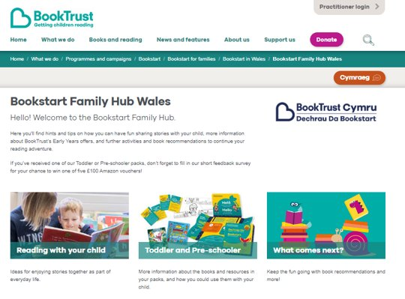
Early Years: Resources for Parents
Alongside the physical packs, BookTrust Cymru has also created a digital Family Hub.
Here, families can find further activities, read-along videos, book suggestions and advice on reading with their child.
Families can access the Hub via the QR code on the back of their pack, or by going to booktrust.org.uk/familyhubwales

Slide 10
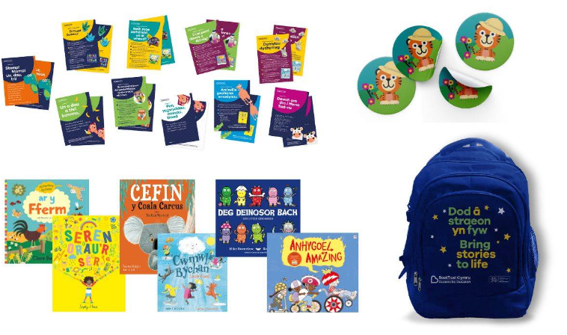
Resources for Partners – Storyteller Toolkit
Some partners will receive these additional resources to support them in sharing stories with families. They can be used in settings as part of group storytelling sessions with families, or with individual families at home.

Slide 11
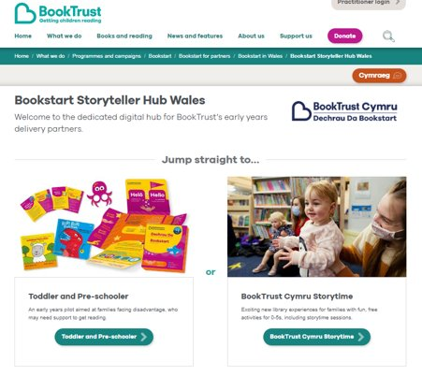
Digital Resources for Partners
The Bookstart Storyteller Hub is a dedicated space for information and tools to help you support families on their reading journeys.
Here you will find:
Information on what’s inside your packs and how you could use them
Downloadable resources, booklists, activities
Storytelling tips from
Michael Rosen
Videos to share with families
A letter to share with
Parents and Carers
Social media templates
for you to share what’s
going on in your setting
with families

Slide 12
Gifting your packs
When you receive your packs:
Gift the packs to families that you work with
Encourage children and their parents or carers to explore the contents of their packs together
Talk to families about the benefits of shared reading
Signpost families to the Bookstart Family Hub for further activities and support
Encourage families to provide feedback on their packs by taking part in BookTrust’s online Family Survey

Slide 13
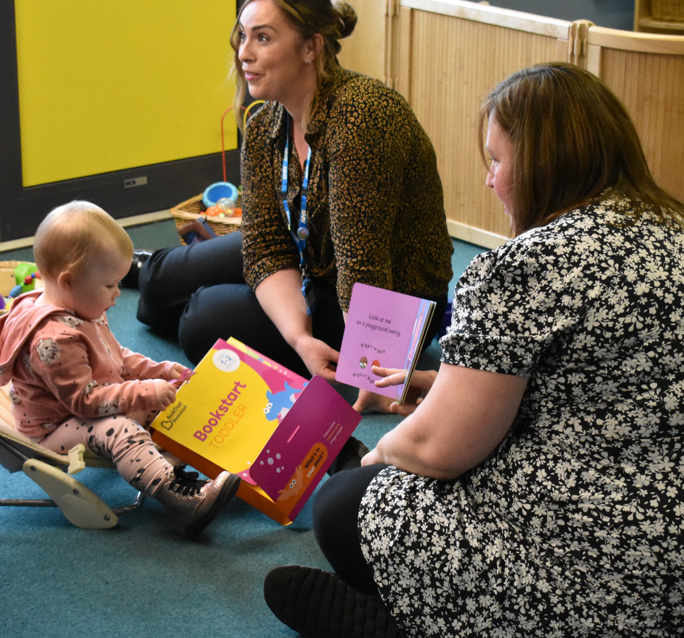
Creating an impactful gifting moment
Some families may need more help to make shared reading a regular part of their lives. BookTrust’s research has told us that modelling how families can use the packs, and incorporating storytelling into the gifting experience can make gifting more impactful.
Families who remembered someone explaining and modelling how to use the pack were more likely to read and share stories more with their child (90%) than those who did not (75%).
The next slide offers a few tips to help
families to incorporate books into their
lives on a more regular basis.

Slide 14
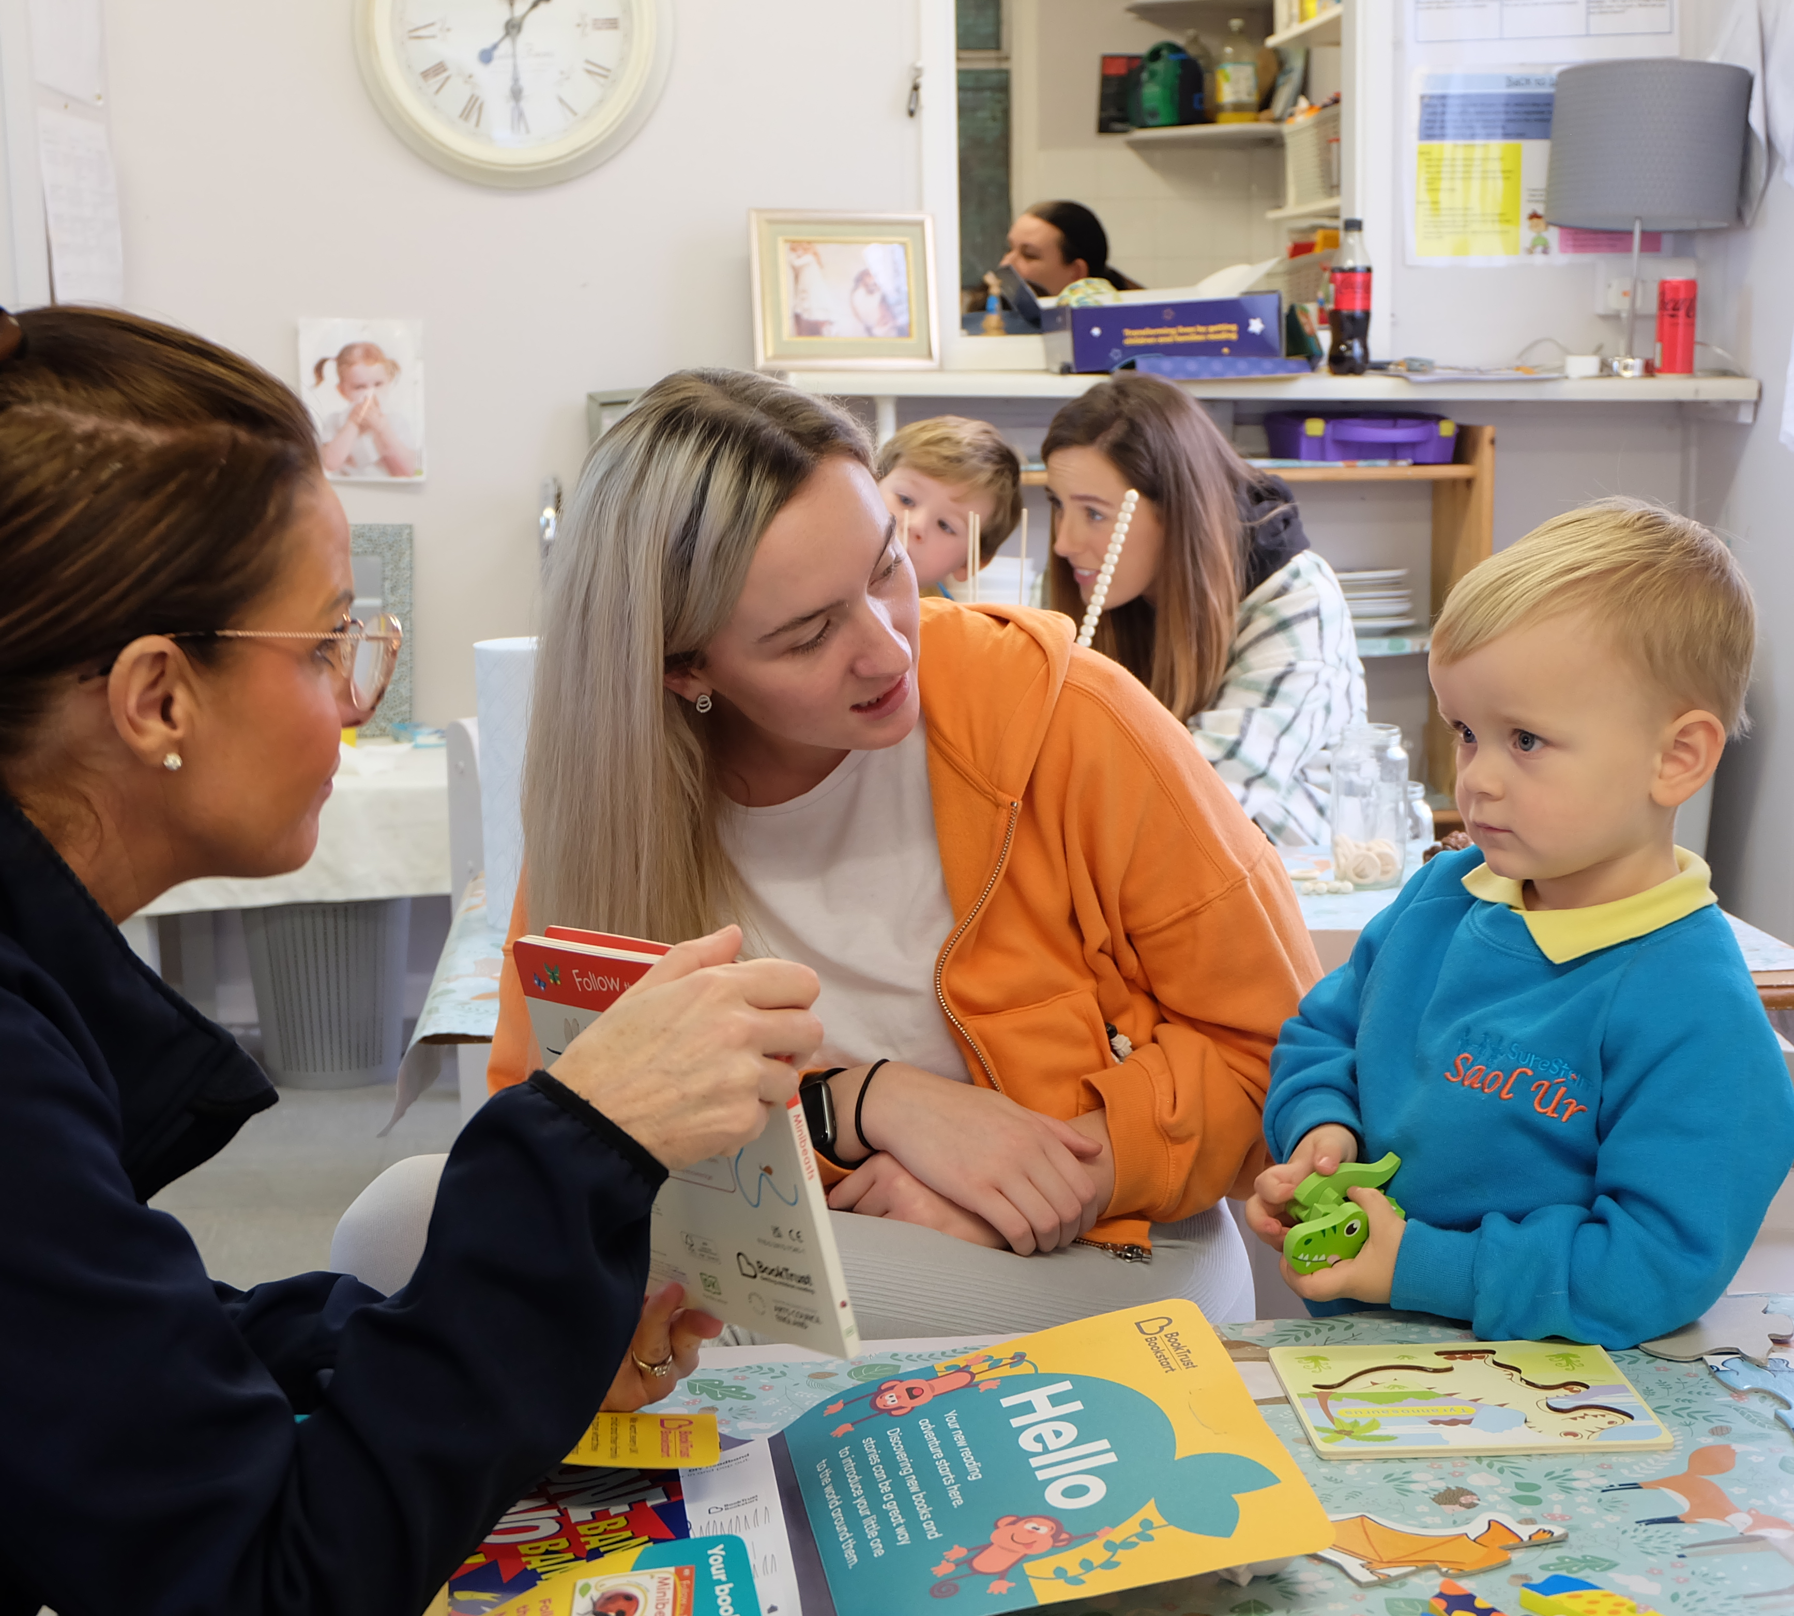
Creating an impactful gifting moment
Point out that books are great for out and about as well as for home!
Sometimes a little role play with a staff member just focusing on a child’s interest and not reading the story cover to cover can help parents to feel a bit more confident – it doesn’t have to be word perfect. Talk about the pictures, have fun, and enjoy the interaction.
Share the activity cards with families to give them ideas for how to enjoy the stories at home. Perhaps demonstrate one during a session first, to help families feel a bit more confident.

Slide 15
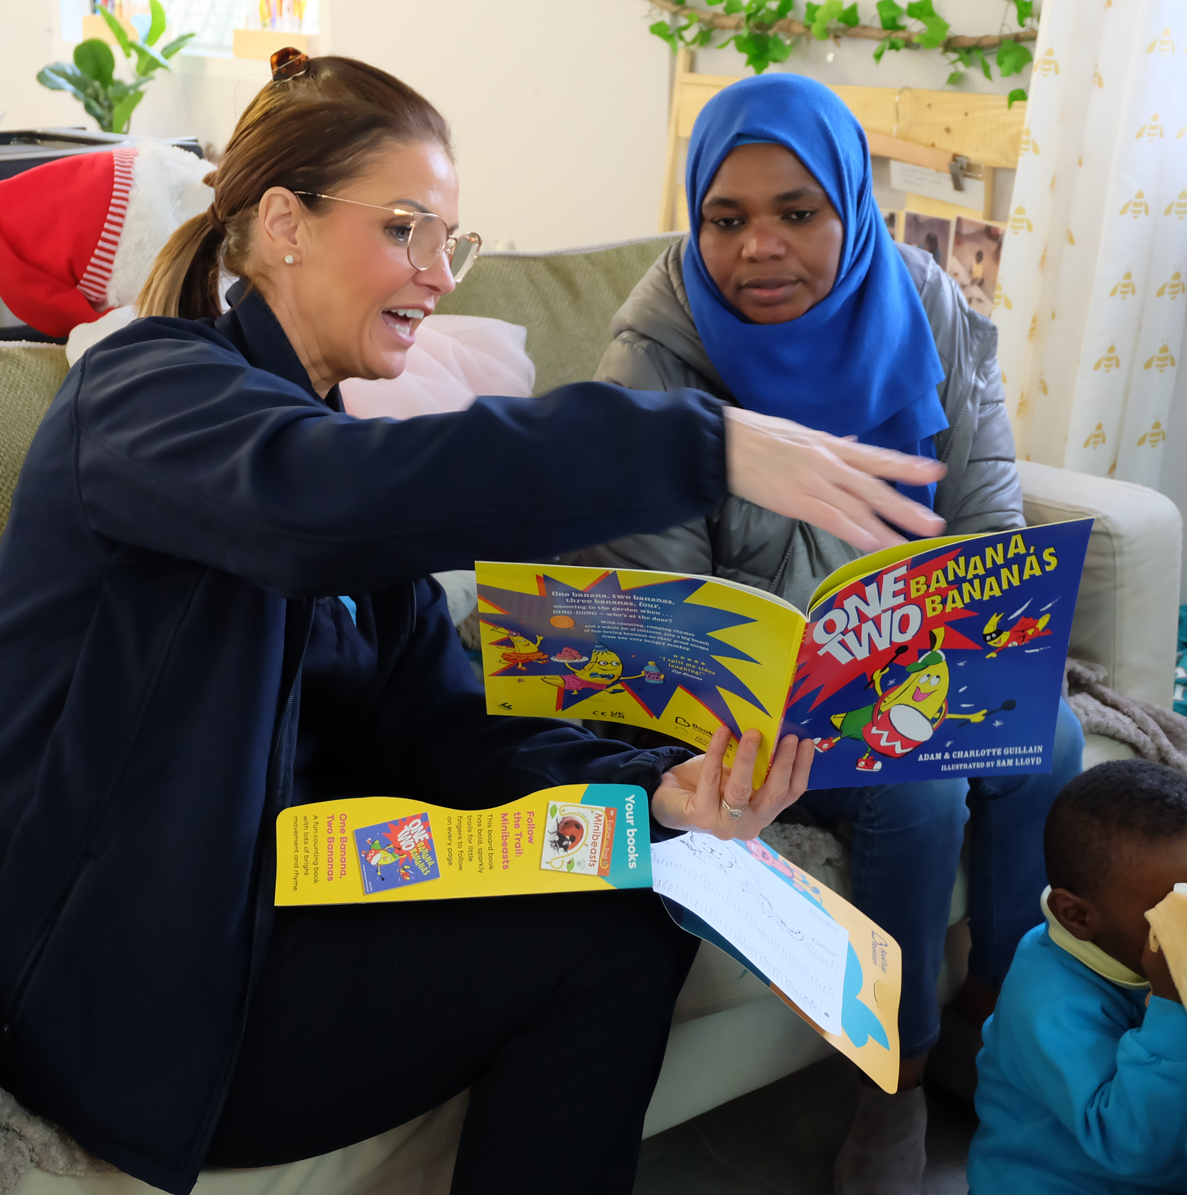
Building confidence to share stories
We know that not all parents and carers find reading with their child easy. Here are some messages you may wish to share with the families you work with to help increase their confidence:
There is no wrong way to share a story. Having fun together is way more important than getting the words 'right'!
A book doesn’t need to be read from cover to cover to get the benefits.
It doesn’t matter who is sharing stories, anyone can read with children - the more the better!
It’s never too late to start sharing stories.

Slide 16
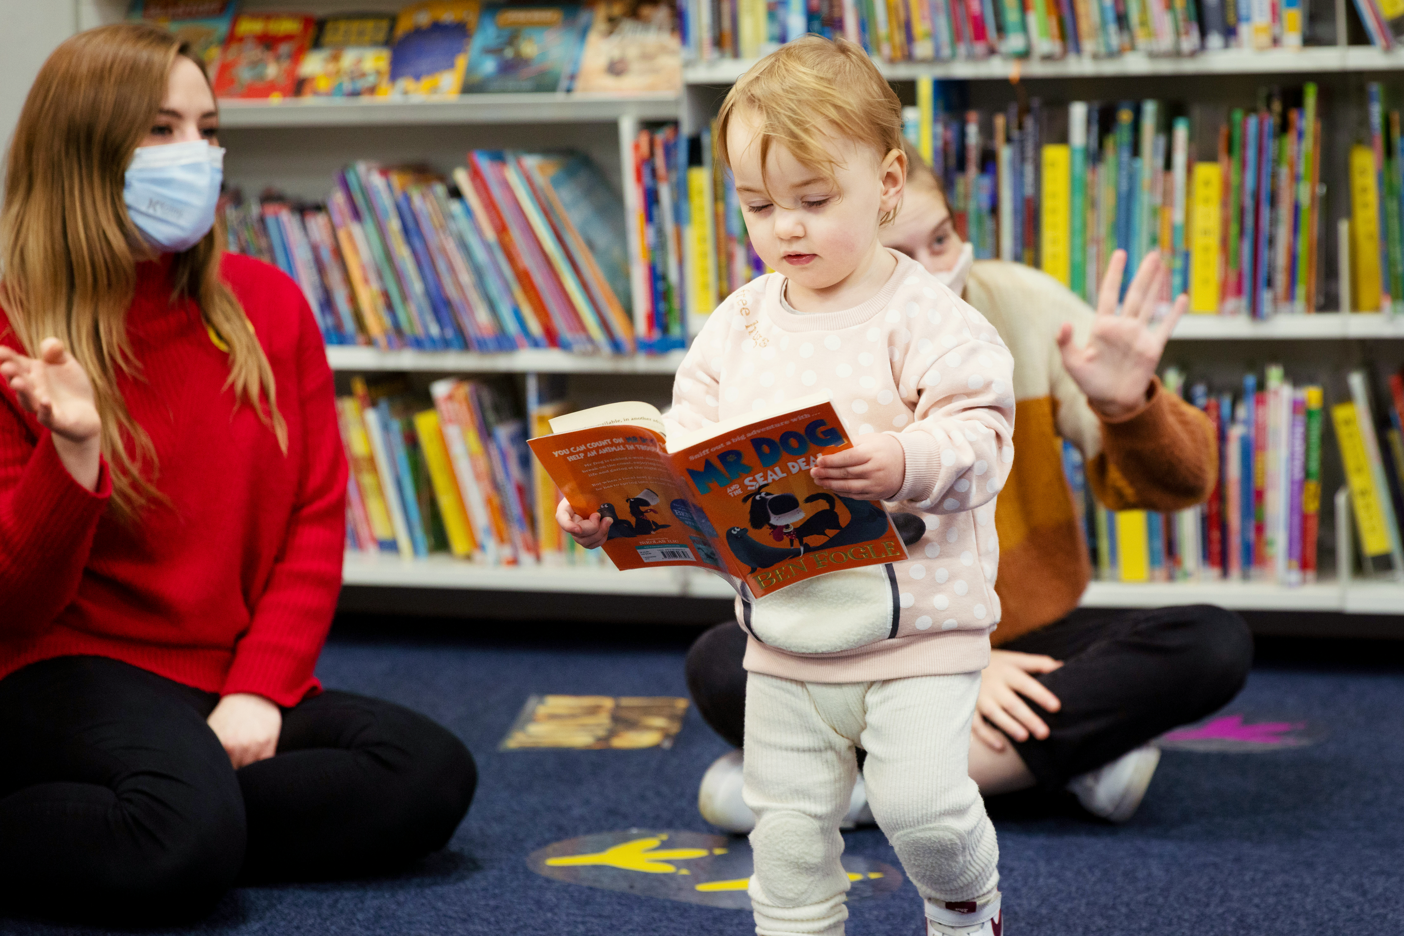
Libraries
As well as having lots of great books that families can enjoy together, many libraries run regular story and rhyme sessions for children to enjoy. Why not encourage families to visit their local library to continue their reading journey?
Your local Bookstart Coordinator will be able to help signpost you to your local library.

Slide 17
Useful links and further information
BookTrust Cymru's Bookstart Family Hub
Author permissions
BookTrust Cymru's Bookstart Storyteller Hub for partners
Sign up to BookTrust’s Early Years Newsletter for regular updates: Newsletter sign up · BookTrust Portal
Contact your local Bookstart Coordinator for more information about BookTrust Cymru in your area.

Slide 18
Thank you for helping to get children reading

