Slide 1
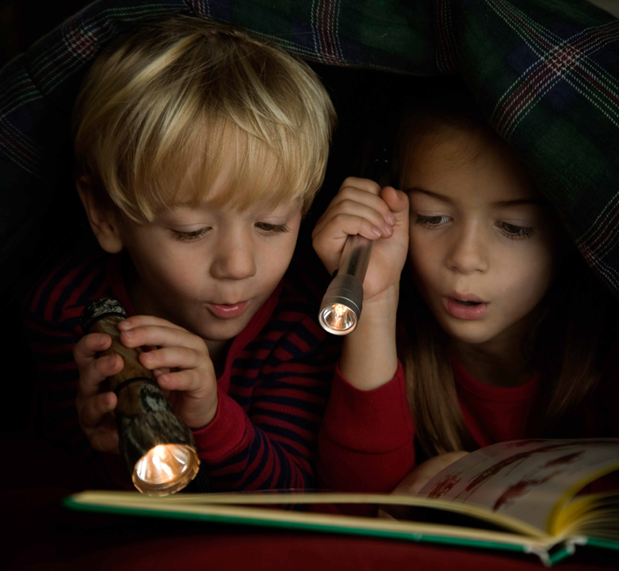
It’s not a book, it’s a doorway.

Slide 2
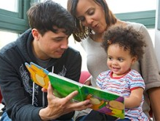
BookTrust is the largest reading charity in the UK.
We work to transform lives by getting children and families reading.
We give out over 5 million books to children every year through our programmes!
Notes:
For more information about BookTrust, please visit www.booktrust.org.uk

Slide 3
The Letterbox Club

Slide 4
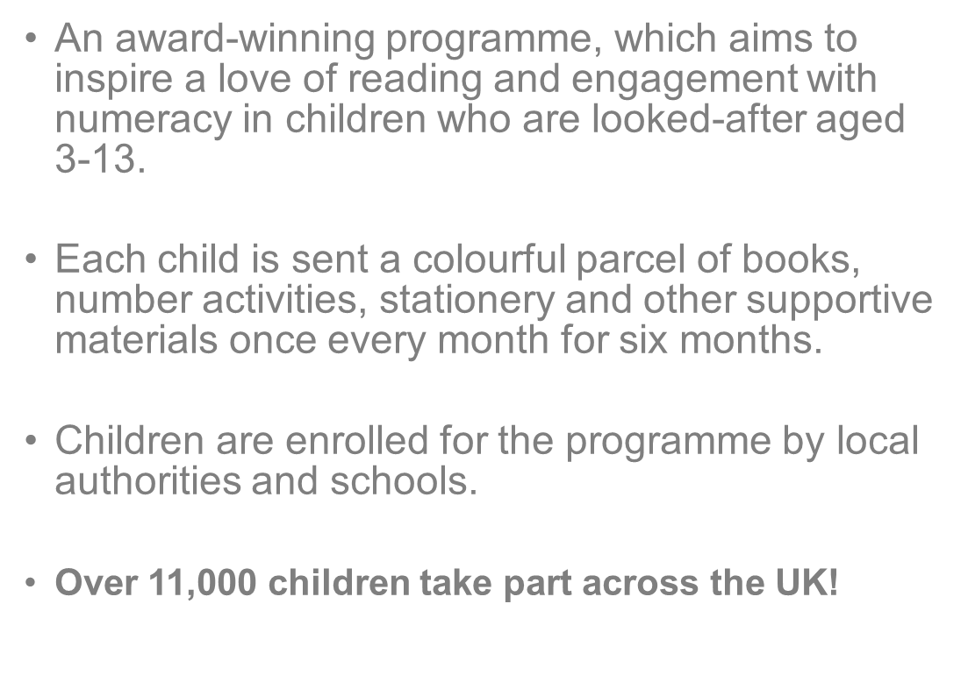
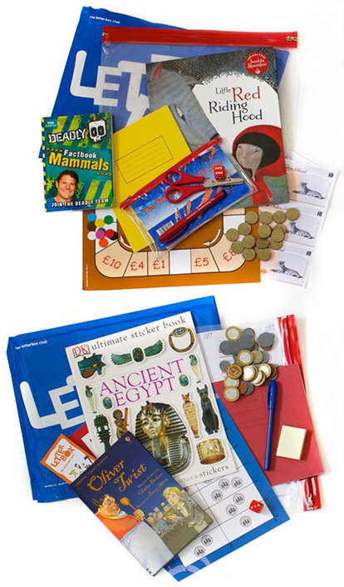
Notes:
The Letterbox Club is run by Book Trust, in partnership with the University of Leicester – it all started with a small pilot in Leicester in 2003!
Getting a parcel through the post is exciting for anyone and the Letterbox Club uses this excitement to encourage children who are looked-after and other children aged 3 to 13 to engage with reading at home. The overarching aim is to inspire a love of reading and engagement with numeracy, whilst encouraging a sense of shared learning with their carers.
Parcels are usually sent from May to October to cover the summer holiday period and to support a smoother transition to the next school year.

Slide 5
Letterbox Parcels
There are six different parcel sets:
Purple - to support children in the EYFS (ages 3-5)
Orange - children in Year 1, to follow them into Year 2 (ages 5-7)
Yellow - children aged 7-9 who are not yet reading independently
Blue - children in Year 3, to follow them into Year 4 (ages 7-9)
Red - children in Year 5, to follow them into Year 6 (ages 9-11)
Green - young people in Year 7, to follow them into Year 8 (11-13)
Notes:
If local authorities (LA) or schools have child who is lower or higher ability, they can choose the parcel that will suit them most – we leave this up to the knowledge and expertise of the LA or school!
The parcels do not have the ages/ year groups written on them for this reason. Each school/LA can request to see the contents of each colour to help them decide what’s best.

Slide 6
More than just a parcel…
Each child receives a letter explaining what's in their parcel, as well as letters from the authors of the books and extra items like bookmarks and writing activities!
An independent panel of experts select the most appropriate, best-written and illustrated books.
“I thought WOW when I got the parcel because I have never ever had a package or a parcel in my entire life I am 10 years old” Shannon
Notes:
The books selected include a mix of different genres to give the children access to a wide selection of material, including: fairy tales, classic and contemporary stories, picture books, novelty/joke books, poetry, non-fiction and audio books.
Each year there’s an independent book selection panel, containing a mixture of professionals. Letterbox Club coordinators/ LACE workers/ librarians/ publishers/ carers/ care leavers etc. to ensure we gain a variety of views/ the best books are selected
Books are selected that capture interest and imagination and that stimulate a dialogue between families and children, and also between children and their peers.

Slide 7
The books really matter...
‘If you're ever looking for speed of impact...I have a year 3 pupil who has just received their first blue pack. This is a child who is highly resistant to reading (he has been permanently excluded from mainstream school). He has arrived this morning for an off-site outdoor adventure visit and has come equipped with his Usain Bolt book asking staff if he could read it on the bus!!!
Amazing!! Thank you!’
Notes:
The following quote shows the importance of including a range of books, both to widen reading and to find what really inspires different children.

Slide 8
Parcels can be enjoyed on their own and shared with others!
The Letterbox Club isn’t homework; children can use the parcels at their own pace.
We hope that the Letterbox Club will encourage children to be more interested in reading, number, drawing, as well as talking to their carers or family members about the parcels!
Remember, taking just a few minutes each day to share a story or talk about books can be a great way for families to spend time together, and can make a huge difference!
Notes:
The Letterbox Club parcels are a great way to encourage shared reading and talking between carers and children about the contents of the parcels.

Slide 9
What are the key benefits?
Children feel 'remembered' and are excited about receiving their parcels
Carers/families and their children spend more time together reading and playing games
Children read to others and share books
Children have increased confidence in reading and number
Parcels are delivered despite placement moves and give continuity to the child
“I wish you could have seen his face light up when he came in from school and saw his parcel waiting for him to rip open – these parcels gave extreme and lasting pleasure.” (Carer of Year 5 boy)
Notes:
Full evaluation information can be found on the website (including all of the evaluation reports): https://www.booktrust.org.uk/supporting-you/practitioners/our-programmes/letterbox-club/

Slide 10
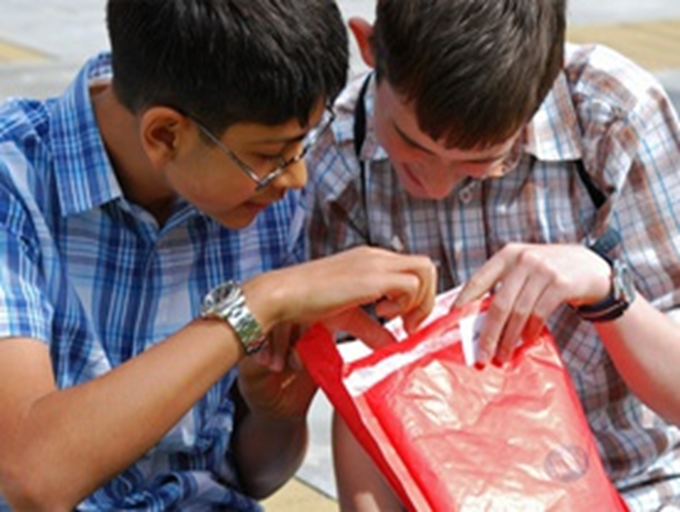
For more information please get in touch at Letterbox@booktrust.org.uk
Notes:
Please add LA/school contact details if relevant

