Slide 1
Reading together with 3-7 year-olds
Notes:
Practitioners may want to explain BookTrust is a children’s reading charity and that they are working with BookTrust to support children who are looked-after to read for pleasure. If relevant, practitioners could mention that BookTrust run the Letterbox Club and are currently trialling materials to provide support for carers/ foster families specifically.
More information about the Letterbox Club can be found here: www.booktrust.org.uk/supporting-you/practitioners/our-programmes/letterbox-club/
More information about BookTrust can be found here: www.booktrust.org.uk

Slide 2
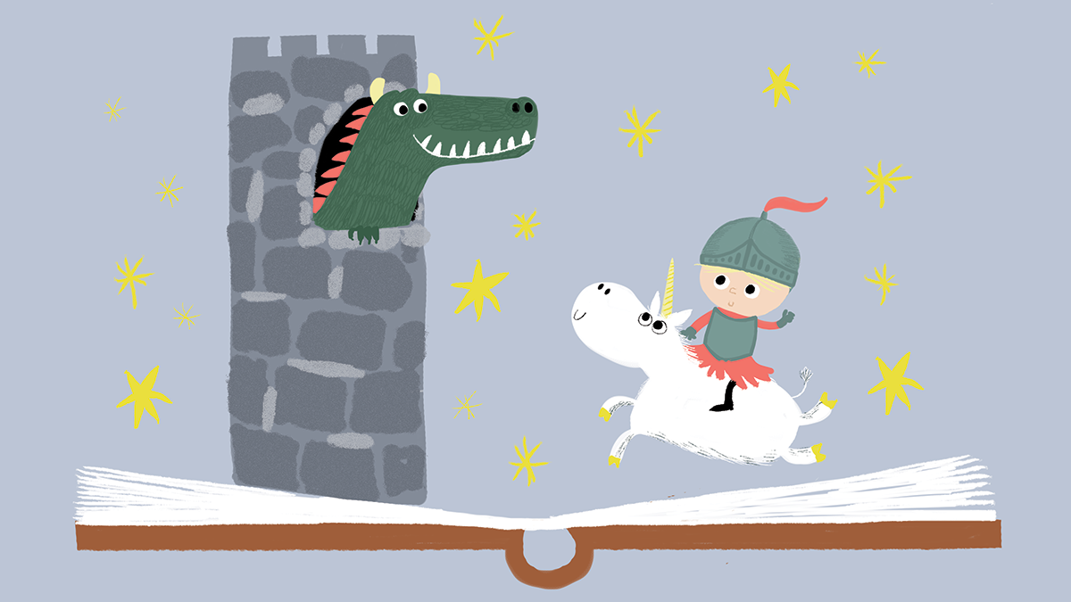
“Being a good role model in reading is one of the best things you can actually do”
Foster carer (NCB, 2017)
Notes:
Supporting your child to read for enjoyment means you can encourage them to read anything, in any format, and talk to them about books.
Research shows foster carers are important reading role models for the children they look after – it’s really important for them to explore books with their child as some children will have missed out on this early experience of book sharing.

Slide 3
Reading together and having fun with stories can have benefits for:
Your child’s wellbeing and confidence: Young people who read for pleasure are more likely to say they have high levels of self-esteem and happiness (Lakey et al., 2017).
The relationship between you and your child: In a nationwide survey, over 90% of carers who read with their child, said it had made a positive difference to their relationship with their child (NCB, 2017).
Your child’s achievement in school: Reading for pleasure is more important for a child’s progress in school than their background and parental factors (Hutton et al., 2015).
Notes:
There is a wide range of evidence showing the varied benefits of reading for enjoyment, including for a child’s reading achievement and progress in school. Although supporting their literacy skill is important, it’s also important that carers do not focus on this instead of enjoyment - the enjoyment factor can have other, wider benefits, for example on the relationship between a carer and their child. Focusing on enjoyment is still important when children start school and start to build their literacy skill.

Slide 4
Practical tips

Slide 5
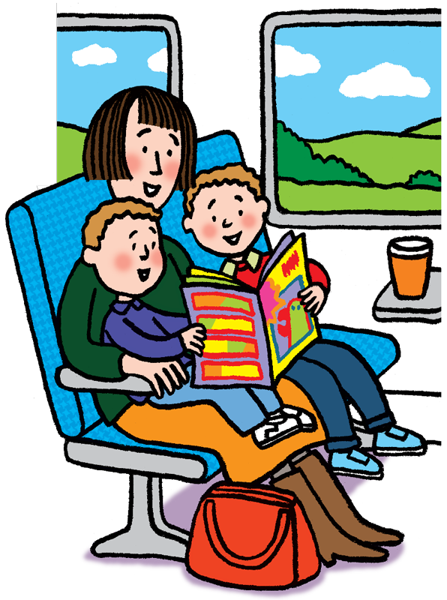
Spending just ten minutes a day reading with your child
and talking about books can make a difference.
You don’t have to start with books. You could try retelling your favourite stories or make up one together.
Read words on signs and posters when you and your child are out and about.
Encourage them to take a book with them for car or bus journeys. They can read wherever they like!
Support your child to do activities related to books, for example drawing their favourite character.
If your child enjoys a particular book and wants to read it again and again, that’s okay.
Notes:
Reading for ten minutes a day does not always have to mean sitting and reading quietly. The focus should be on the enjoyment of the book – it’s about having fun together. Carers of children who are less confident readers might want to try alternating the reading with the child, or starting off reading to them and then encouraging them to join in.
Emphasise that these are just suggestions to get children enjoying reading – carers will be able to make a judgement about what may or may not work for their individual child.

Slide 6
Here are two examples of shared reading. Consider the interaction in each one.
Notes:
Before showing the videos, explain that the footage is self-filmed by people who took part in a BookTrust research project. They are not examples of shared reading that are bad or wrong, they have been chosen because they offer a chance to reflect on what is happening and how the shared reading experience could be adapted.
If time allows, we advise that practitioners play the first video on the next slide and give carers an opportunity to discuss/feedback before moving on to the next one. You may choose to watch specific clips of the videos, if time in the session is quite limited.
Encourage carers to engage – you may need to suggest things for them to look out for, for example how the adult uses their tone of voice, where they hold the book, whether they engage the child by talking to them about the book they are reading together (asking questions, pointing things out on the page etc).

Slide 7
Alternative link to view online
Notes:
The videos in this presentation were self-filmed by participants who took part in a BookTrust research project. Encourage carers to think about how the adult engages the child in reading, then give them some time to talk in pairs or groups about their ideas. Ideas might include:
He asks the child to choose a book they would like to read, but does help guide them by reminding them of the options. Highlight to carers that if their child wants to read the same book more than once, that’s okay.
He sits close to the child so that they can both see the book
He gives the child space to ask questions and answers them ‘Remember- he doesn’t like the cold.’
He uses the tone of his voice to make the story more interesting, for example he uses a higher pitched voice when reading Henry’s speech, and emphasises some words.
He praises the child – ‘You’re right – that’s not a pineapple that’s a coconut.’
He continues to read even when the child has turned around

Slide 8
Alternative link to view online
Notes:
As part of the BookTrust research project, this video was submitted by a parent/carer who read daily with her child.
Whilst watching this video, encourage carers to consider what is happening during the shared reading session. Ask carers to think about how it could be made more enjoyable for the child. Responses could include:
Praising the child and focusing more on the enjoyment of the book.
Talking to the child about what they are reading and asking the child questions about their personal response to the book e.g. – ‘Who is your favourite character? What would you like to happen next?
Encouraging the child to choose a book they would like to read.
The child in this video is a confident reader. Encourage carers to think about what they might do if the child was less confident and how they might adapt their approach.

Slide 9
Talking about books
Talk to your child about the book you are reading together – you might want to start with simple questions e.g. ‘Can you see the hippo on the page?’
If your child is more confident you could ask them more open questions. Try to:
Phrase open questions in a less pressured way, for example ‘I wonder where the hippo is hiding?’ or ‘I wonder if the hippo is in the mud? What do you think?
Give your child time to think before they answer.
Notes:
It’s worth noting that some carers may experience barriers to reading with their child, including:
Lack of time – remind carers that spending just ten minutes a day reading with their child can make a difference. It doesn’t always have to mean sitting down quietly – it could involve talking about a book too.
Their child struggles with concentration – explain to carers that they do not have to read a book in one go with their child. They can read it in short sections and come back to it later. They might also want to try reading non-fiction books with their child as it’s easy to dip in and out of these.
Their child may have a negative view of reading – Emphasise to carers that particularly for children who lack confidence and who do not find reading fun, it’s important to focus on enjoying the book and spending time together rather than on getting every word right. Encourage them to be enthusiastic when sharing books with their child – this will help make it an enjoyable experience for both of them. This might mean that they need to start reading and encourage their child to join in later. Finding short books about topics their child enjoys can be helpful too.
They don’t feel confident reading aloud - If a carer lacks confidence reading aloud, you may want to remind them that an important part of shared reading is about spending time together.
Task suggestion – using short picture books, practitioners could get carers to work in groups/pairs to look through a book and think about a) structured questions that they could ask to engage the child with the book (e.g. Can you help me find the crocodile on the page?) and b) more open questions. Focus on encouraging carers to ask questions in a more conversational way that does not put pressure on the child. For example ‘I wonder where the whale is swimming to?’ ‘Where do we think the jumper might be?’
Recommend that carers with children who are less confident start with simple questions e.g. ‘Can we find the hippo on the page?’ They might want to encourage them to point to pictures on the page as a way of responding. They can also engage their child with books through helping them to do activities related to reading like drawing a book cover or their favourite character.

Slide 10
Finding out more

Slide 11
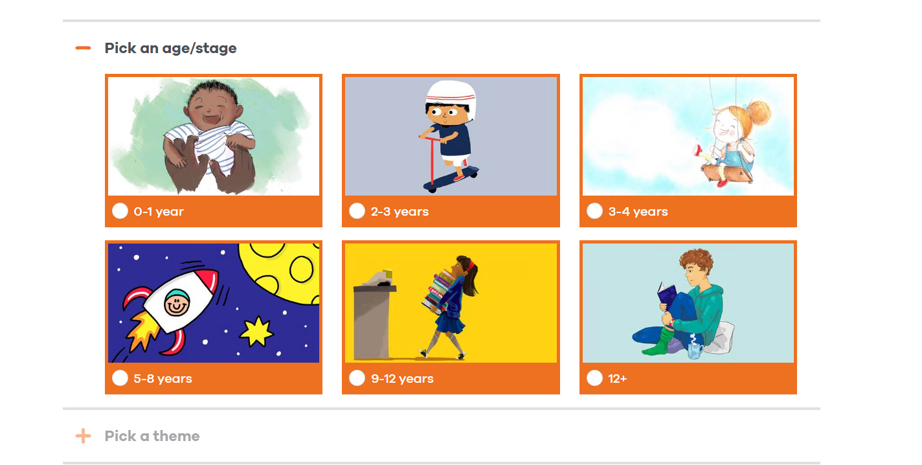
Download the Reading Together booklet, which contains advice and information about reading with your child: booktrust.org.uk/tips-for-carers-and-foster-families
Use BookTrust’s book finder to search for books for your child by age and topic. You can find books about your child’s favourite topics here:booktrust.org.uk/books/bookfinder
Notes:
Practitioners could add information about their local authority’s library service here, including any event information and advice about how carers can sign up the children they look-after.

Slide 12
References:
Hutton, J. S., Horowitz-Kraus, T., Mendelsohn, A. L., DeWitt, T., & Holland, S. K. (2015). Home Reading Environment and Brain Activation in Preschool Children Listening to Stories. Pediatrics, 136(3), 466–478. https://doi.org/10.1542/peds.2015-0359
Lakey, J., McManus, S., Oskala, N., & Smith, N. (2017). Culture, Sport and Wellbeing: Findings from the Understanding Society youth survey. http://www.artscouncil.org.uk/sites/default/files/download-file/Culture%20sport%20and%20wellbeing%20-%20youth.pdf
Rix, K., Lea, J. and Edwards, A. (2017). Reading in foster families. https://www.booktrust.org.uk/globalassets/resources/research/reading-in-foster-families-full-report.pdf

